Slide 1

CZ4032 – Data Analytics & Mining Credit Card Fraud Detection
Team Members: Tan Jian Wei (Leader), Kong Alson, Sam Jian Shen,
Sun Jinghan, Li Zhaochen, Ang Yongxin

Slide 2

Agenda
Problem Statement
Data Pre-processing
Classification Models
Comparison between Different Models
Conclusion

Slide 3

Problem Statement
Increased amount of fraudulent transactions
Lack of accuracy of credit card fraud detection system
Notes:
How can we improve the credit card fraud detection using various data- mining techniques
Fraud is a major problem for credit card companies as large volume of transactions
are completed each day and fraud transactions are inevitable. As such, among
huge chunk of transactions that we see each day consist of frauds which we aren’t yet aware of due to the accuracy of the credit card fraud detection system.
As such, we will be using various data mining techniques which includes, Logistic Regression (LR), Support Vector Machine(SVM), Random Forest (RF), Artificial Neural Network (ANN) to see which is the best model that would help in minimizing the incorrect fraud classifications.

Slide 4
Credit Card Dataset
31 Features:
V1, V2, V3, ……, V28 : principal components obtained with PCA
Time, Amount
Class
Notes:
The datasets contains transactions made by credit cards.
It contains only numerical input variables.
Features V1, V2, … V28 are the principal components obtained with PCA.
Features 'Time' and 'Amount' are features which have not been transformed with PCA.
Feature 'Class' is the response variable and it takes value 1 in case of fraud and 0 otherwise.

Slide 5
Tools Used
Programing Language: Python
Software: Google Colab
Libraries Used: pandas, numpy, sklearn, matplotlib, seaborn, tensorflow, etc …

Slide 6
Classification Models
Logistic Regression (LR)
Support Vector Machine (SVM)
Random Forest (RF)
Artificial Neural Network (ANN)

Slide 7

Data Pre-processing
Exploratory Analysis
Removing Outliers
Feature Selection
Splitting into training and testing set
Dealing with imbalanced class - Oversampling
Notes:
For data preprocessing, we performed the following steps, first (next slide)

Slide 8
Exploratory Analysis
Dataset statistics : 284807 rows, 31 columns
Check for missing values : no missing values
V1 - V28
float
PCA
Independent Variables (30)
Time
float
Features
Amount
float
Dependent Variable (1)
Class
int
0 - valid, 1- fraud

Slide 9
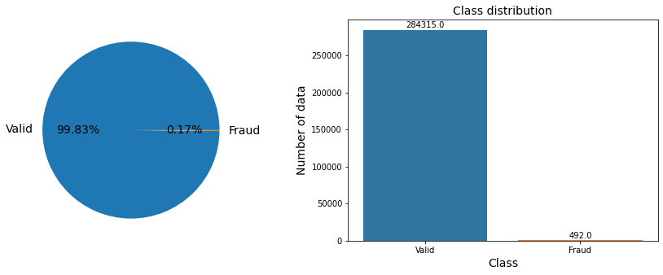
Exploratory Analysis
Class distribution - Imbalanced

Slide 10
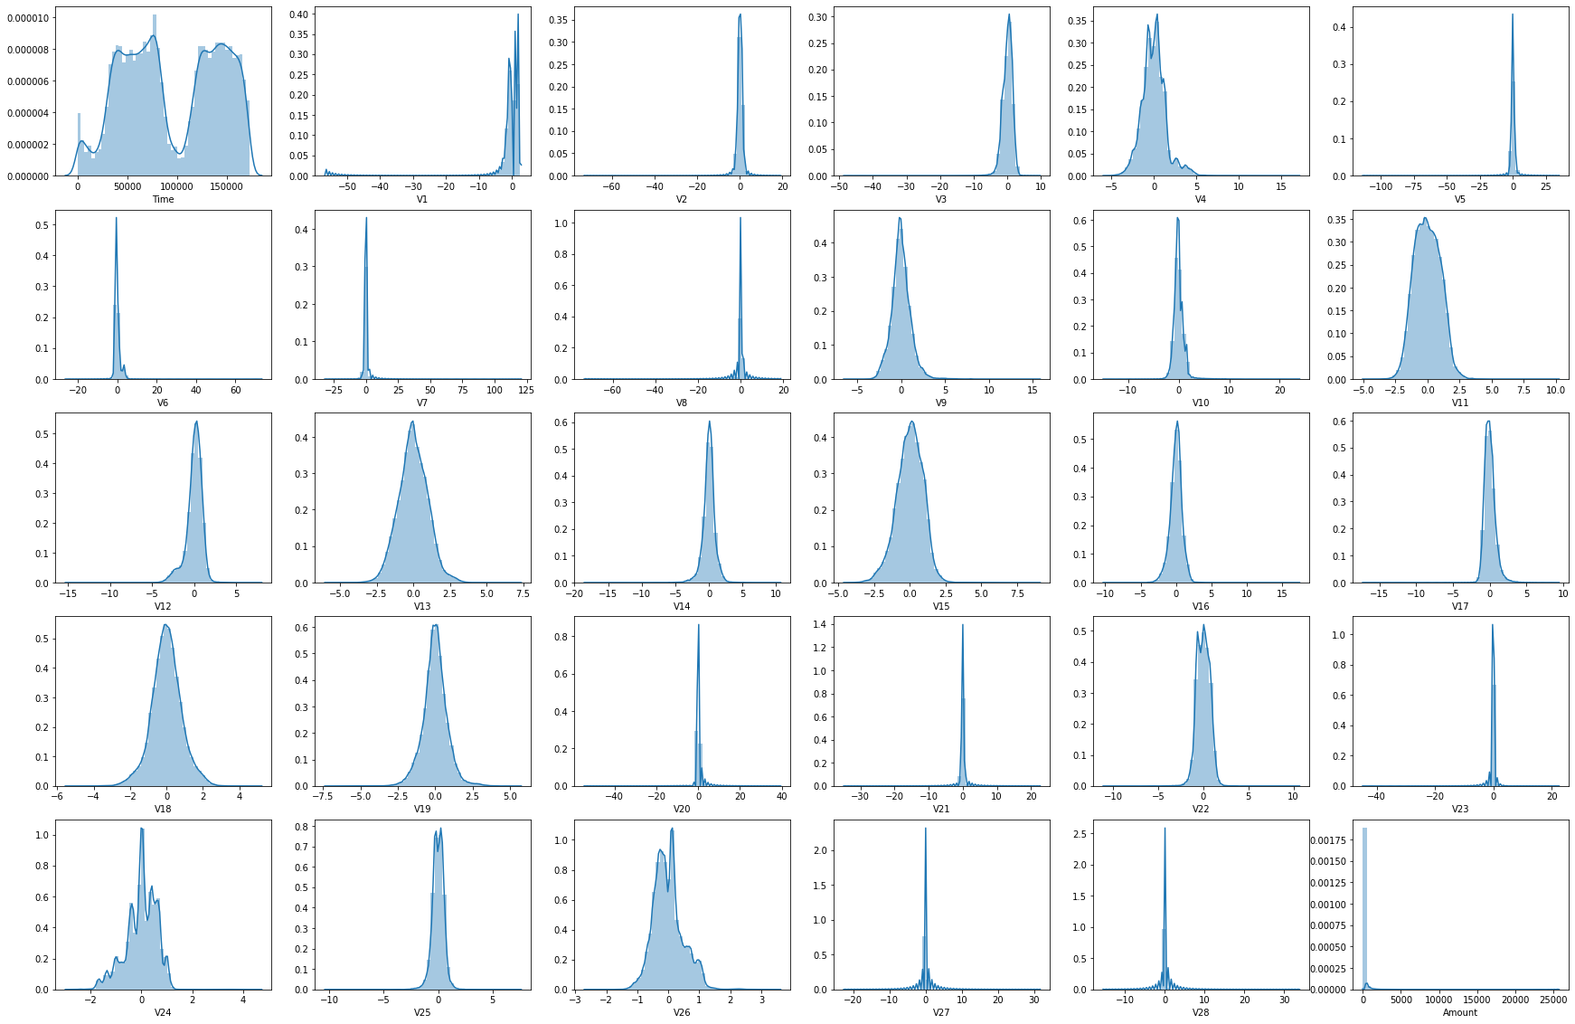
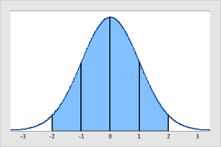
Remove Outliers
features selected for outlier removal:
V1, V2, V3, V4, V5, Amount
remove data outside 3 standard deviation of normal distribution
Distribution of each feature
Notes:
So as you can see from the slide there are some features that are not normally distributed so what we going to deal with it is to remove data……. and the final result we going to remove the outliers of V1 to V5 and the amount column.

Slide 11
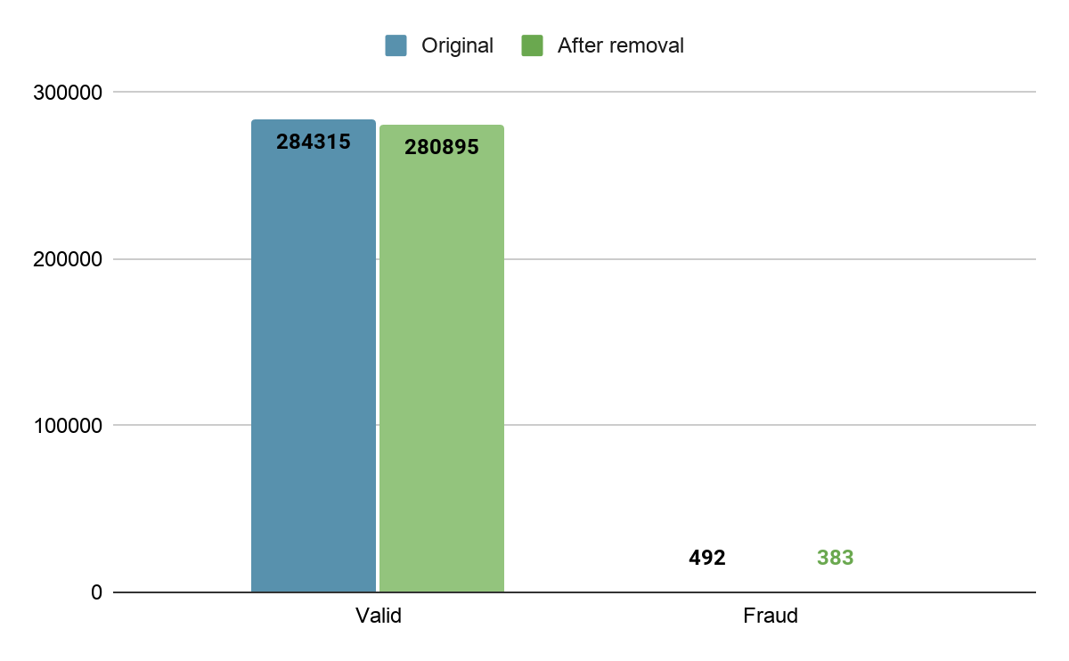
Remove Outliers
Total removal : 3529
valid : 3420
fraud: 109

Slide 12
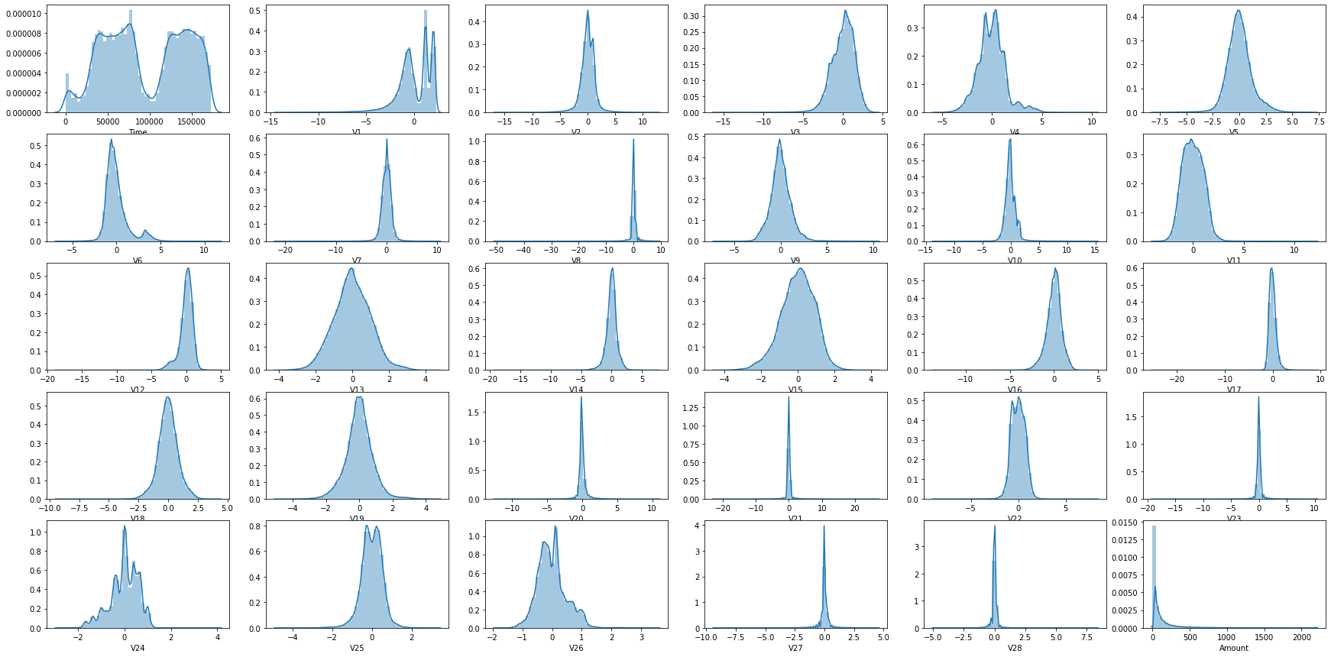
Remove Outliers
Distribution of each feature after removal:

Slide 13
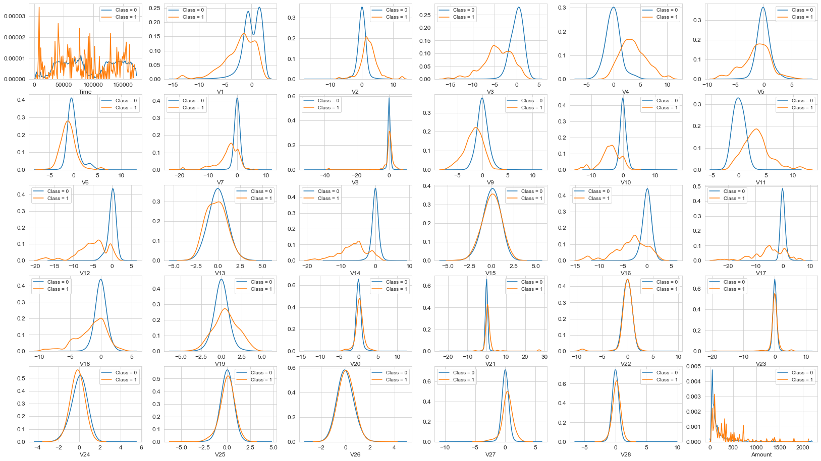
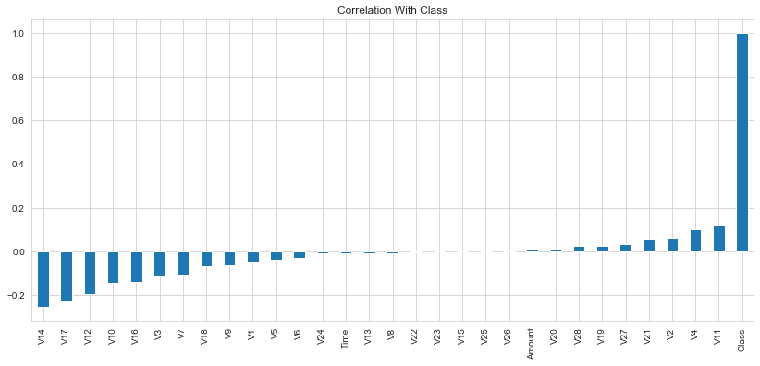
Feature Selection
Distribution with Class
Correlation with Class

Slide 14
Feature Selection
Features to be removed:
Time, V8, V13, V15, V20, V21, V22, V23, V25, V26, V28
Remaining features - 19 independent variables

Slide 15
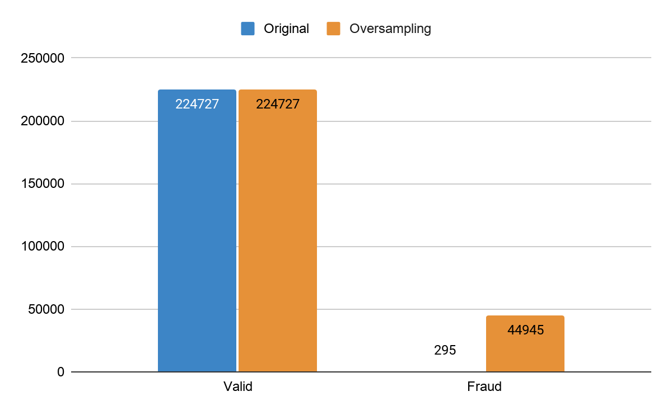
Dealing with Imbalanced dataset - Oversampling
Splitting into training and testing set
split ratio: 80% : 20%
Oversampling on training dataset
Method: SMOTE
After oversampling
Class 0 : Class 1 = 5 : 1
Dataset size after oversampling

Slide 16
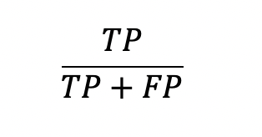
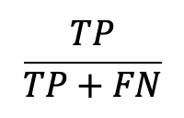
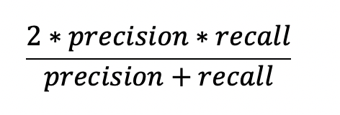
Evaluation Metrics
Confusion matrix
Precision Score :
Recall Score :
F1 Score:
Precision-Recall Curve → Focus more on minority class, i.e.fraud transactions
AUC score

Slide 17
Classification Models

Slide 18

Logistic Regression

Slide 19

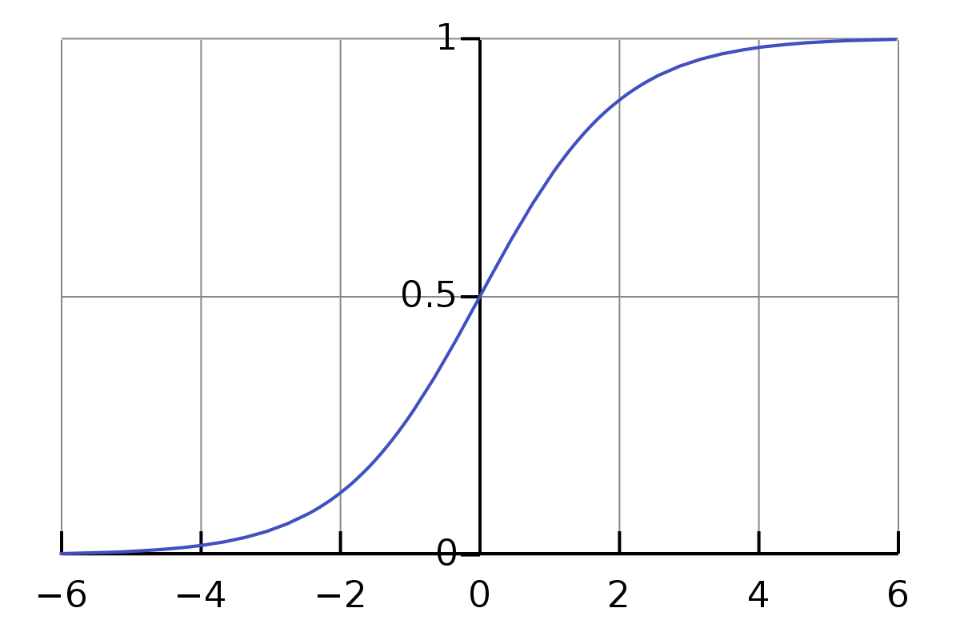

Logistic Regression
Generalized linear model, based on theory of linear regression
Non linearity through sigmoid function
Input x: array of features, {x1, x2, x3 …… xn, 1}
Label y: 0 or 1
Weight w: {w1, w2, w3 …… wn, b}

Slide 20


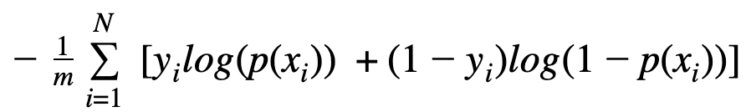
Optimize the weight
Maximum Likelihood
Probability of the training set
Cost function
Gradient Descent: w = w - α * d(J(θ))/d(w)

Slide 21
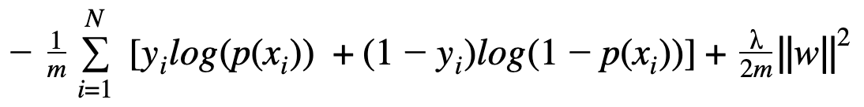
Regularization
Prevent Overfitting

Slide 22
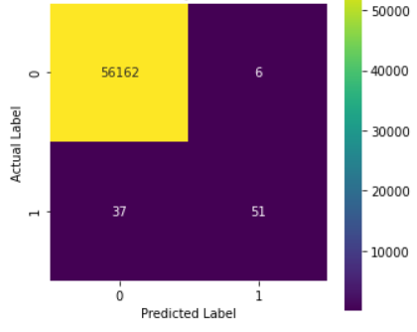
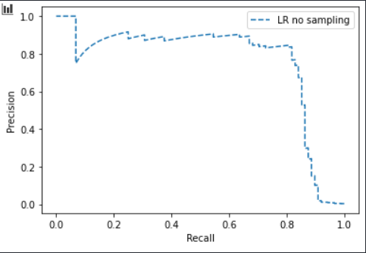
Result - before oversampling
Confusion Matrix
Precision-Recall Curve
threshold=0.5
Precision: 0.894
Recall: 0.579
f1-score: 0.703
AUC-score: 0.738
(using default threshold for fraud : 0.5)

Slide 23
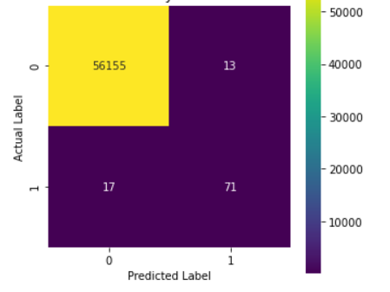
Result - before oversampling
Threshold Moving
Confusion Matrix
Precision-Recall Curve
threshold=0.5
threshold=0.1
Precision: 0.840
Recall: 0.802
f1-score:0.825
AUC-score: 0.738
Change threshold for fraud to 0.1

Slide 24
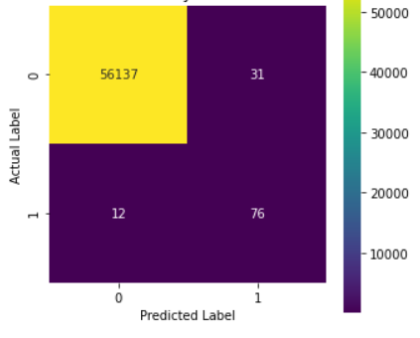
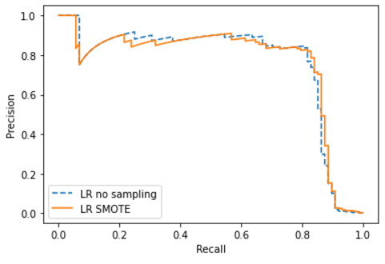
Result - after oversampling
Confusion Matrix
Precision-Recall Curve
Precision: 0.700
Recall: 0.852
f1-score: 0.814
AUC-score: 0.763
(using default threshold for fraud : 0.5)

Slide 25
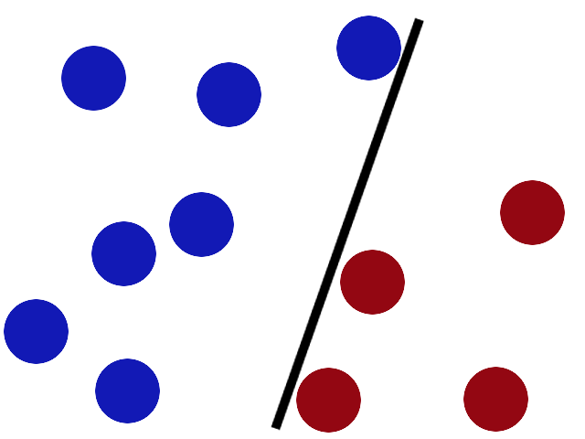
Support Vector Machine(SVM)

Slide 26
Radial Basis Function(RBF) kennel
Gamma(γ)
C

Slide 27
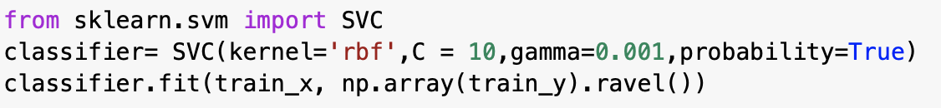
Fine-tuning
Grid search method
list of parameter (gamma and C)
kernel
obtain the best g and C.

Slide 28
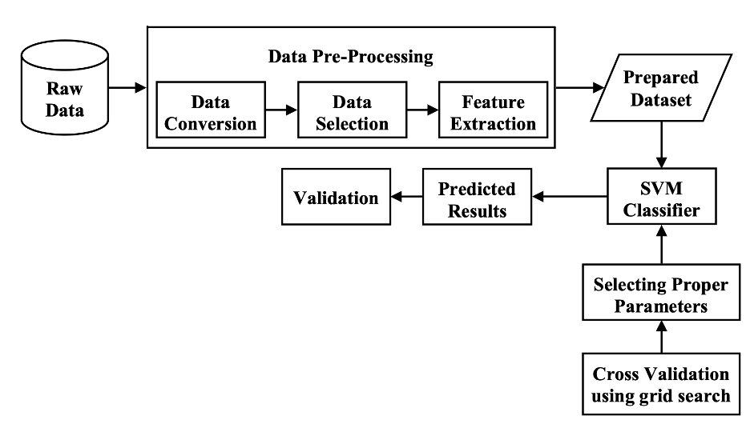
SVM Model

Slide 29
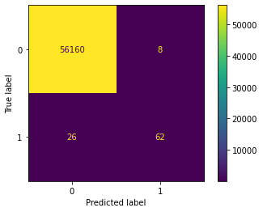
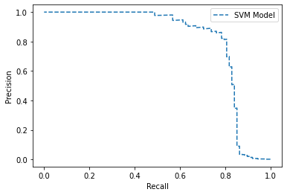
Result-without sampling
Confusion Matrix
Precision-Recall Curve
Precision: 0.886
Recall: 0.705
F1 Score: 0.785
AUC : 0.810
(using default threshold for fraud : 0.5)

Slide 30

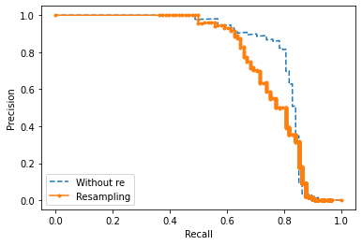
Result-with oversampling
Confusion Matrix
Precision-Recall Curve
Precision: 0.399
Recall: 0.807
F1: 0.526
AUC : 0.762
(using default threshold for fraud : 0.5)

Slide 31
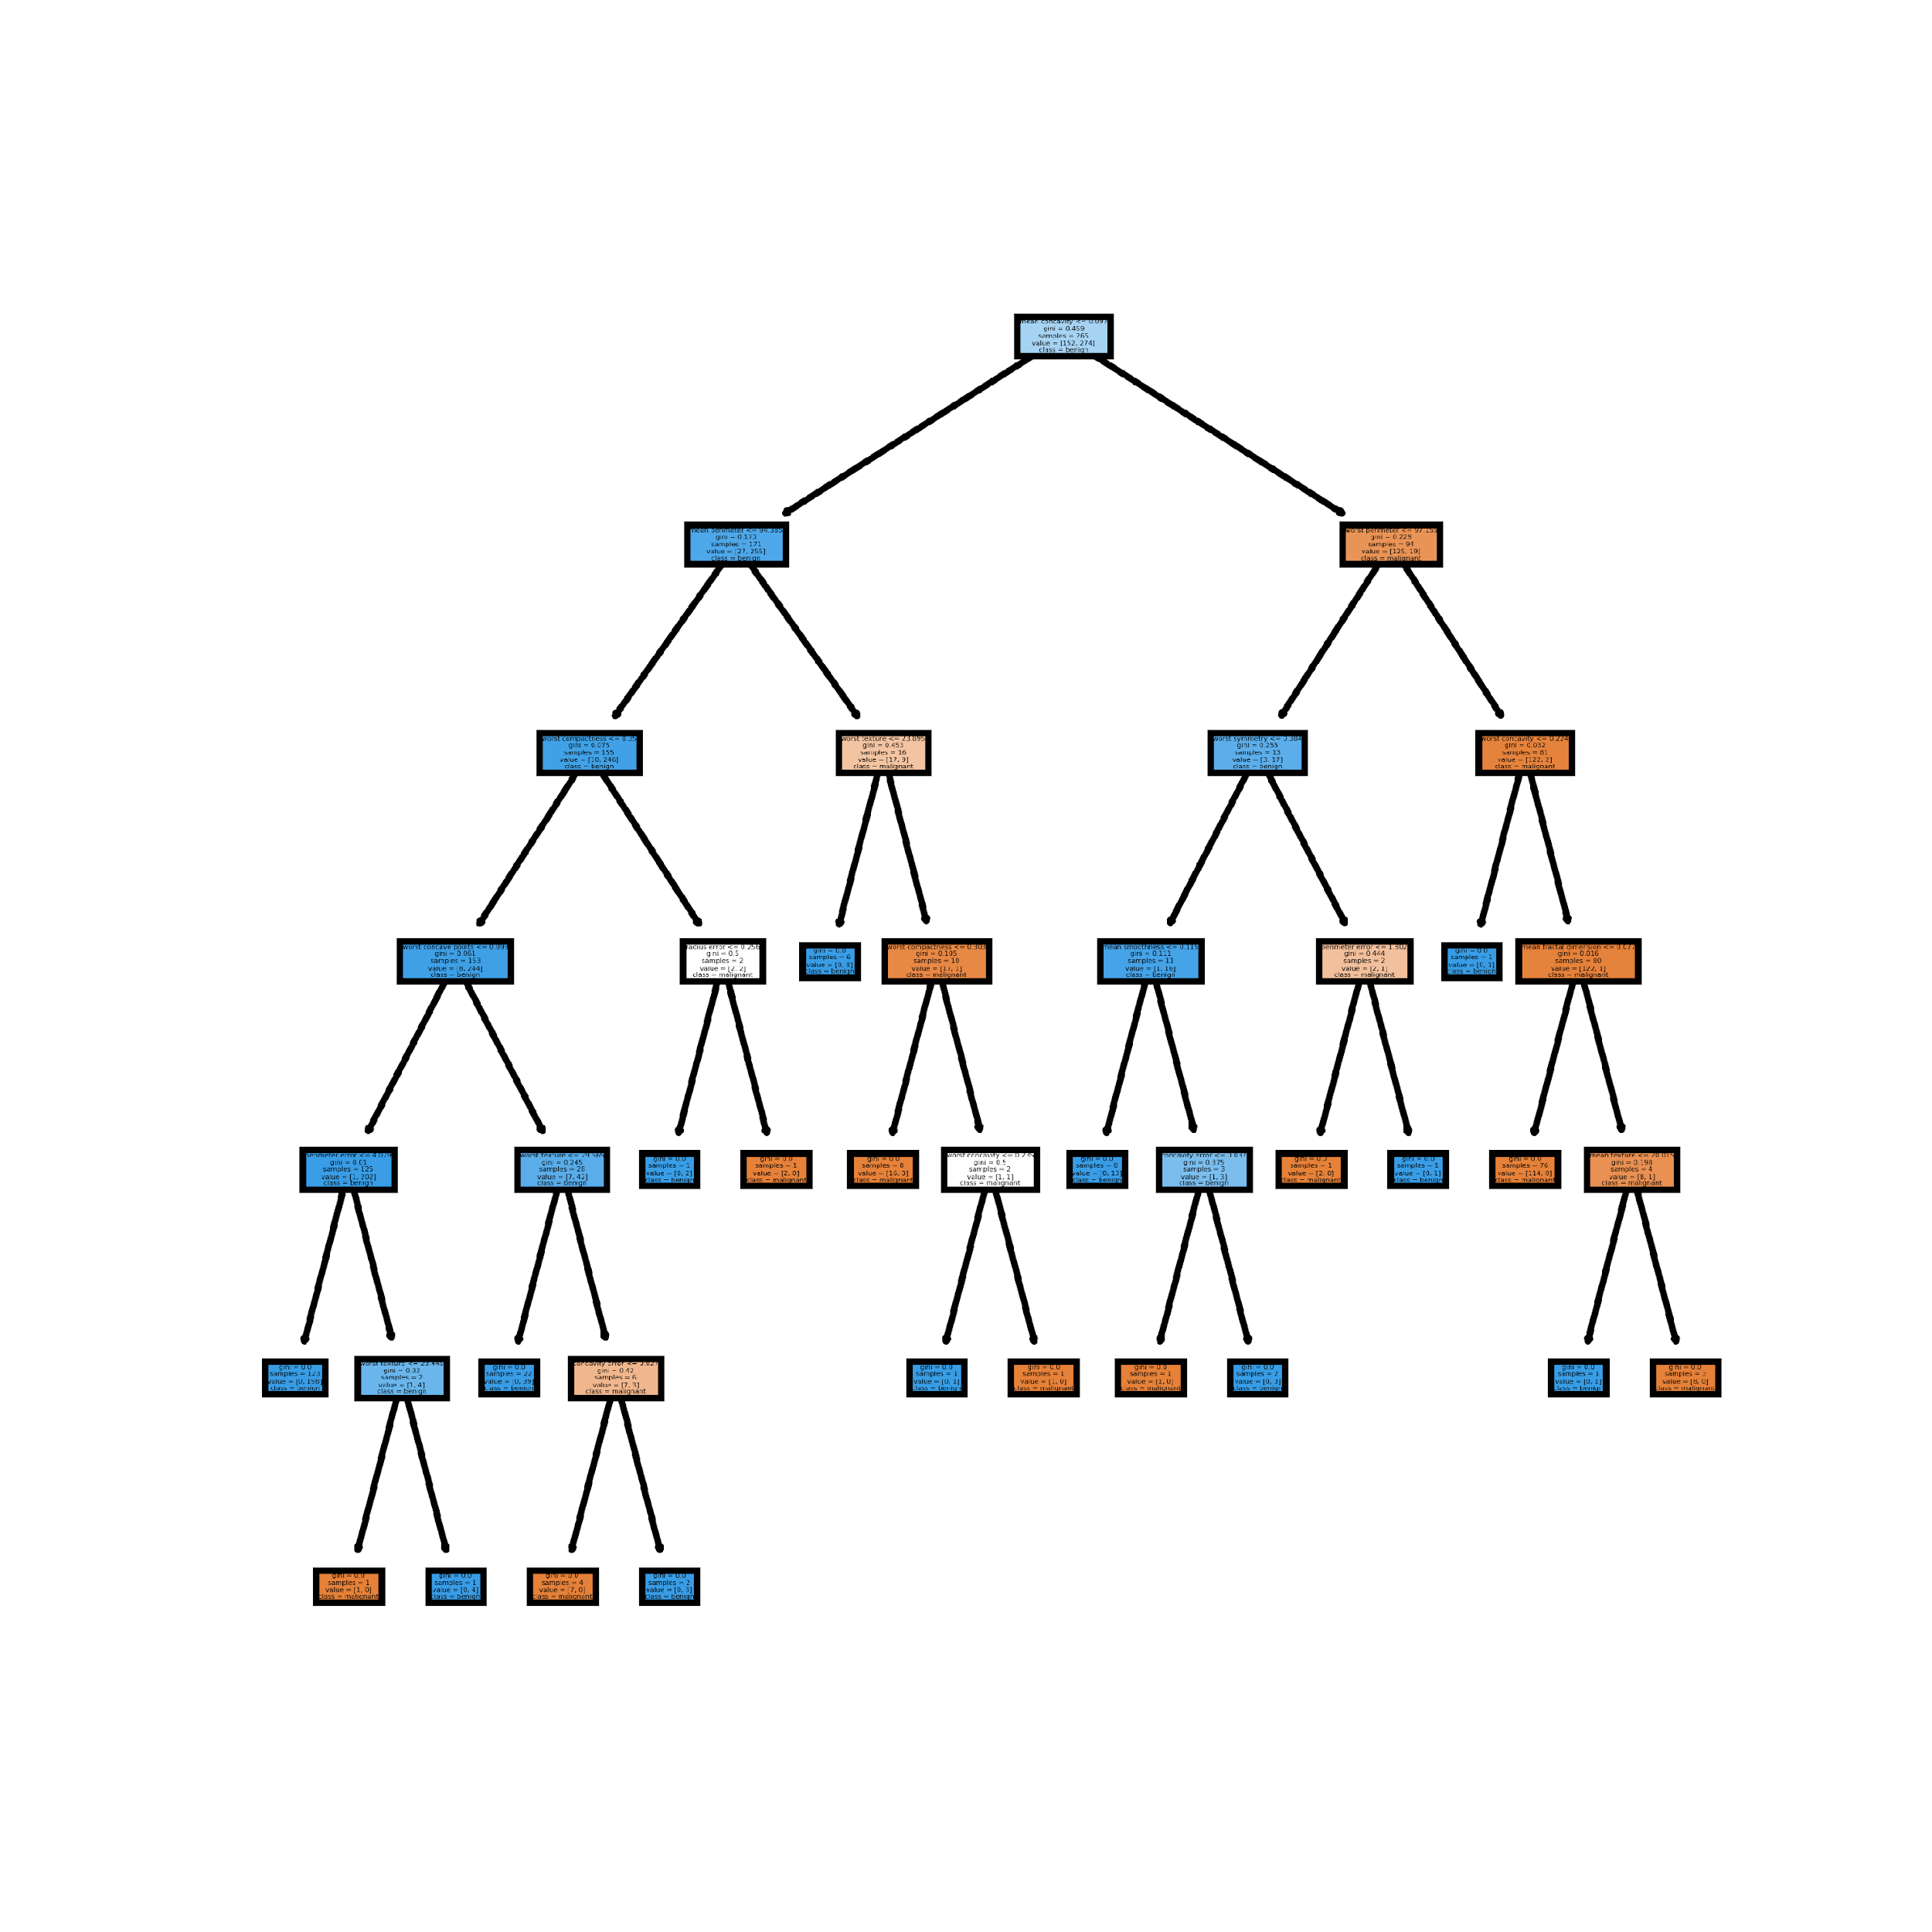
Random Forest

Slide 32
Type of Random Forest
Random Forest Classifier
Used to predict a set of specified labels - The simplest( and most hackneyed) example being that of Email Spam Detection where we will always want to classify whether an email is either spam (1) or not spam(0) .
Random Forest Regressor
used to predict real valued outputs which vary and don't require outputs predicted to be in a fixed set. For example when wanting to predict the future income of restaurants, we really don’t know all the possible outputs.

Slide 33
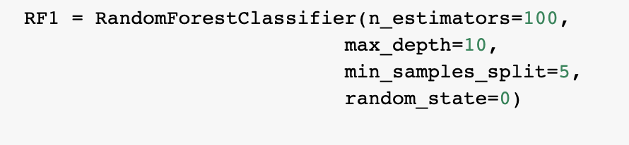
Implementation

Slide 34
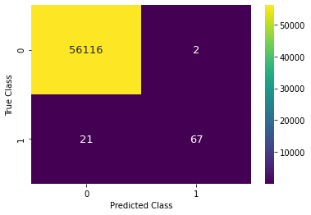
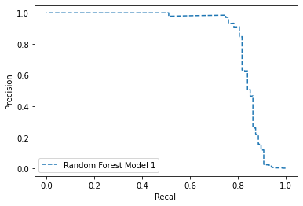
Result - before oversampling
Confusion Matrix
Precision-Recall Curve
Precision: 0.971
Recall: 0.761
F1: 0.854
AUC score: 0.843
(using default threshold for fraud : 0.5)
Notes:
The higher the AUC, the better the performance of the model at distinguishing between the positive and negative classes
Precision: This tells when you predict something positive, how many times they were actually positive. whereas,
Recall: This tells out of actual positive data, how many times you predicted correctly.

Slide 35
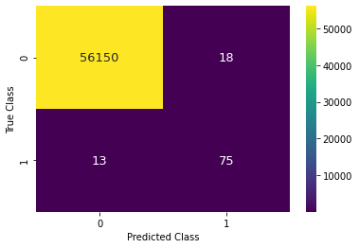
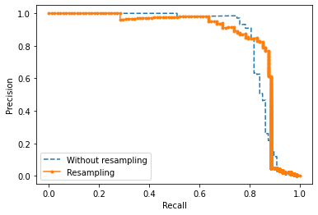
Result - after oversampling
Confusion Matrix
Precision-Recall Curve
Precision: 0.806
Recall: 0.852
F1: 0.829
AUC score: 0.848
(using default threshold for fraud : 0.5)
Notes:
The higher the AUC, the better the performance of the model at distinguishing between the positive and negative classes
Precision: This tells when you predict something positive, how many times they were actually positive. whereas,
Recall: This tells out of actual positive data, how many times you predicted correctly.
Note that the Precision- Recall Curve is better than the original data after we oversample the data

Slide 36
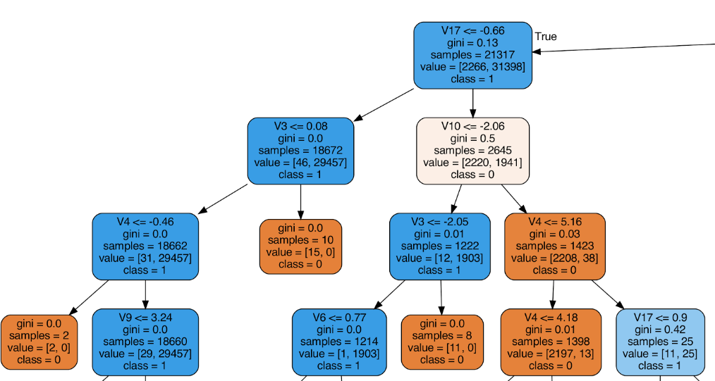
Random Forest
Gini coefficient is a measure of inequality of a distribution

Slide 37

Artificial Neural Network

Slide 38
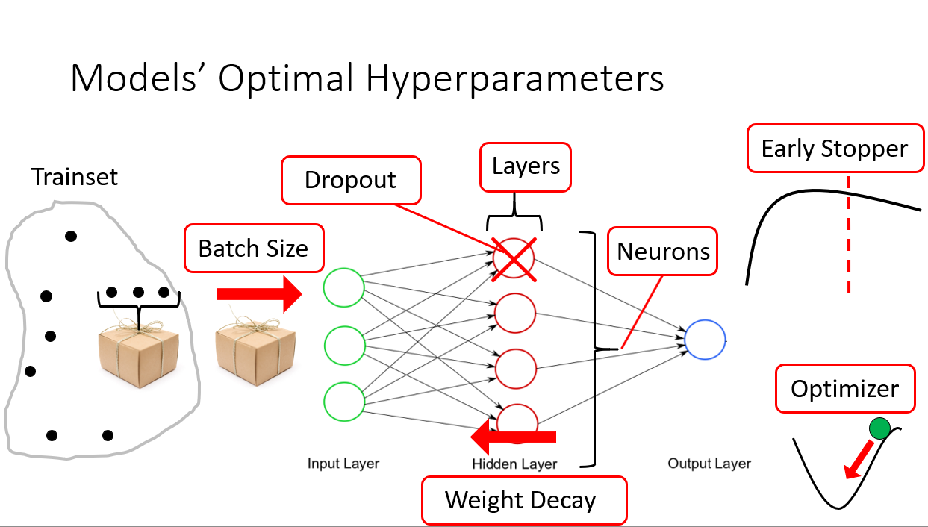

Slide 39
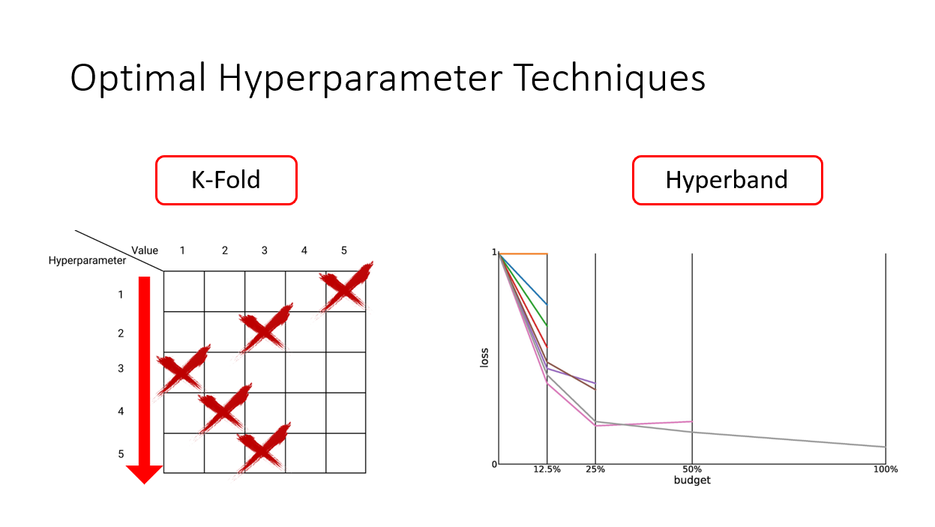

Slide 40
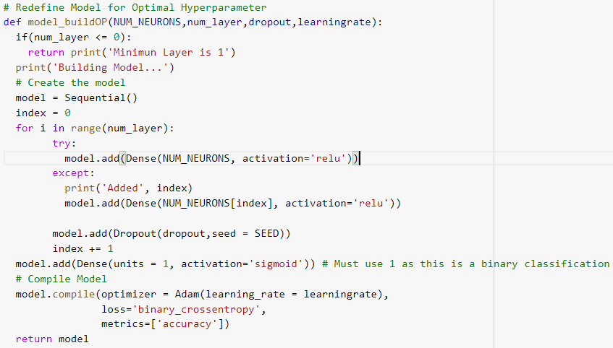
Implementation - Building Model

Slide 41
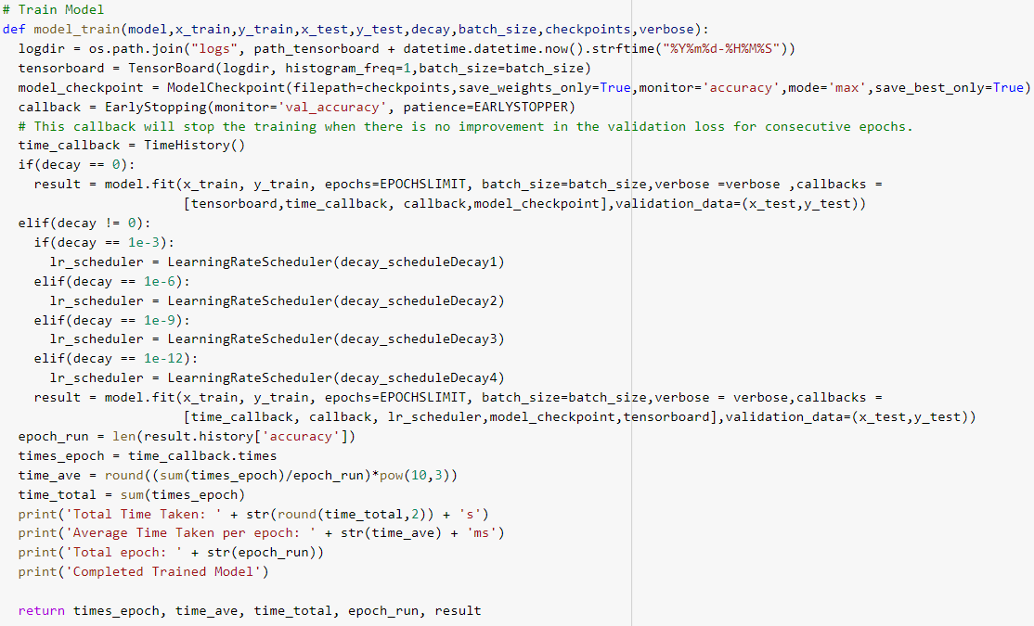
Implementation - Training Model

Slide 42
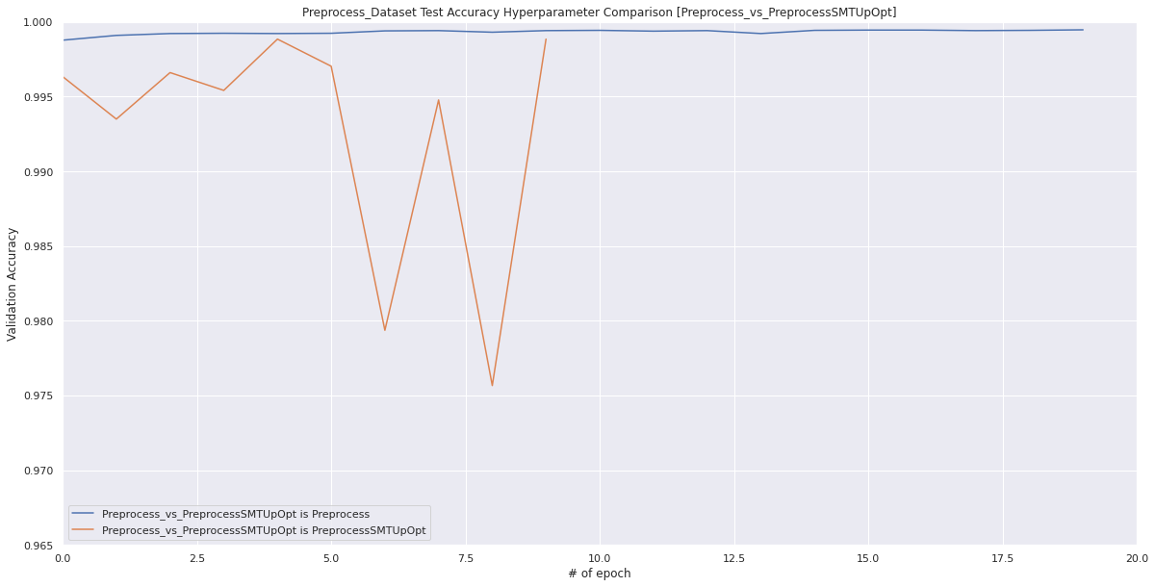
Result
Test Accuracy Comparison
Optimal Hyperparameter Used
Preprocess with SMOTE
Preprocess
Optimal Neurons L1 = 10
Optimal Layer = 1
Optimal Learning Rate = 0.01
Optimal Dropout Rate = 0.2
Optimizer = Adam
Batch Size = 32
Weight Decay = 0
Optimal Neurons L1 = 20
Optimal Layer = 1
Optimal Learning Rate = 0.001
Optimal Dropout Rate = 0
Optimizer = Adam
Batch Size = 32
Weight Decay = 0

Slide 43

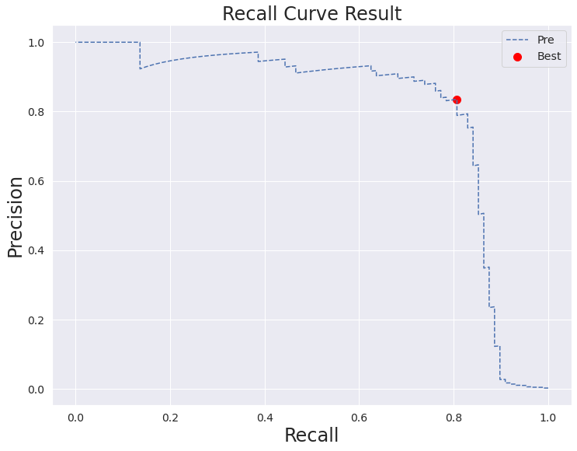
Result - before oversampling
Confusion Matrix
Precision-Recall Curve
threshold=0.5
Precision: 0.882
Recall: 0.762
F1 Score: 0.817
AUC: 0.806
(using default threshold for fraud : 0.5)

Slide 44

Result - before oversampling
Confusion Matrix
Precision-Recall Curve
Threshold Moving
threshold=0.5
threshold=0.294
Precision: 0.826
Recall: 0.807
F1 Score: 0.821
AUC: 0.806
Change threshold for fraud to 0.294

Slide 45

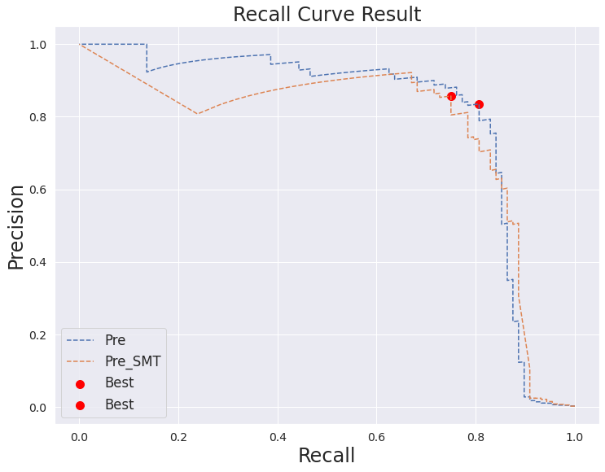
Result - after oversampling
Confusion Matrix
Precision-Recall Curve
threshold=0.5
Precision: 0.589
Recall: 0.864
F1 Score: 0.700
AUC: 0.765
(using default threshold for fraud : 0.5)

Slide 46

Result - after oversampling
Confusion Matrix
Precision-Recall Curve
Threshold Moving
threshold=0.975
threshold=0.5
Precision: 0.857
Recall: 0.750
F1 Score: 0.800
AUC: 0.765
Change threshold for fraud to 0.975

Slide 47
Comparison between Different Models
Topic: Credit Card Fraud Detection

Slide 48
Comparison between Different Models
Classification Model | Precision | Recall | F1 Score | AUC Score Precision Recall Curve
Logistic Regression | 0.700 | 0.852 | 0.814 | 0.763
Support Vector Machine (SVM) | 0.886 | 0.705 | 0.785 | 0.810
Random Forest | 0.806 | 0.852 | 0.829 | 0.848
Artificial Neural Network (ANN) | 0.807 | 0.826 | 0.821 | 0.806
Random Forest provides highest precision and recall

Slide 49
Conclusion
Topic: Credit Card Fraud Detection

Slide 50
Conclusion
Imbalanced dataset - Oversampling can help improve the model
Random Forest provides the best prediction result
Final prediction on testing set
Precision : 80.6%
Recall : 85.2%
Confusion Matrix
(Decision threshold for fraud transactions is 0.5)

